Slide 1
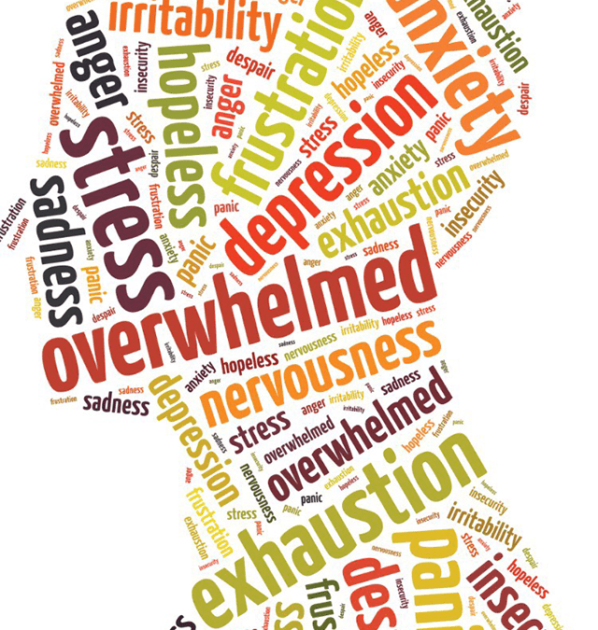
BadgerBreak
Project Kick-Off Presentation
Shruti Sharma, Alex Goldsmith, Ryan Gillespie, James Deng

Slide 2
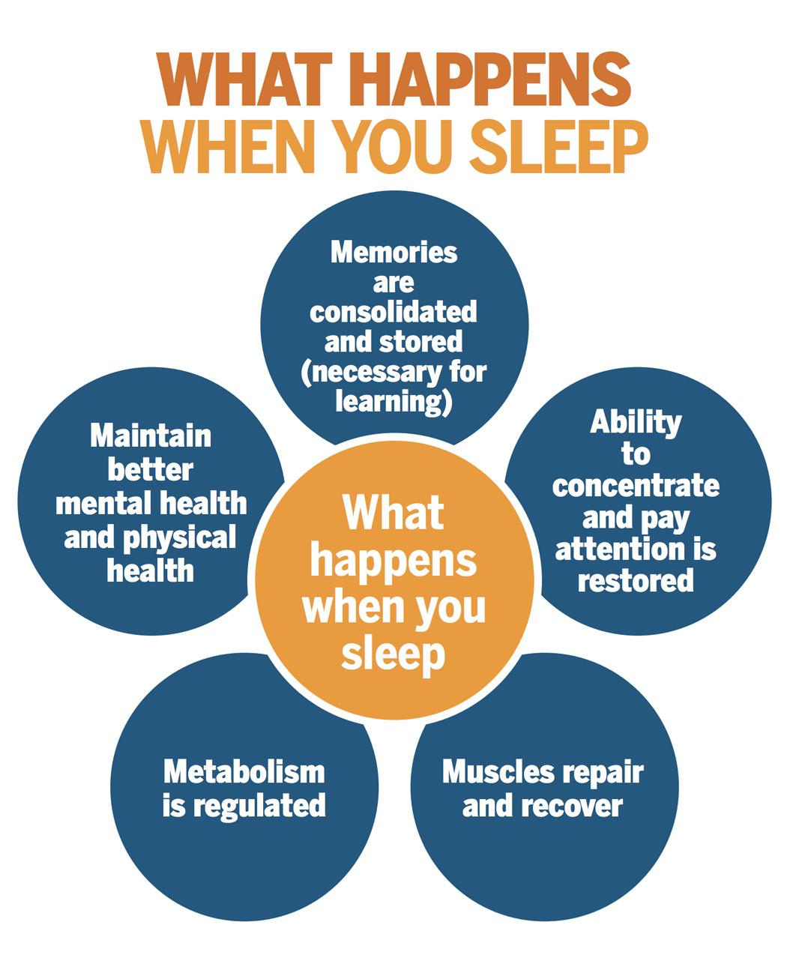

Overview
BadgerBreak is intended to be a cross-platform mobile application that is a free, self-guided Mental Health resource for UW-madison students.
Its main features will include :-
10-15 emotion-based assessments
Community board for posting, liking and possibly sharing other posts created under an alias name
Study tracker to aid students set study goals and stick with it
Sleep tracker
Guided Meditation animation
Collection of user-provided “coping cards” to aid with difficult emotional states
Notes:
A clear description of what you will deliver at the end of the project (be specific about the problem you are trying to solve)
A summary of what work has occurred to date (i.e. meeting with the client, iteration planning, proposed layout)
A concise description of anticipated problems and how you plan to manage them (i.e. risks)
A projection of where the work is going (tutorials, coding expectations, etc)

Slide 3
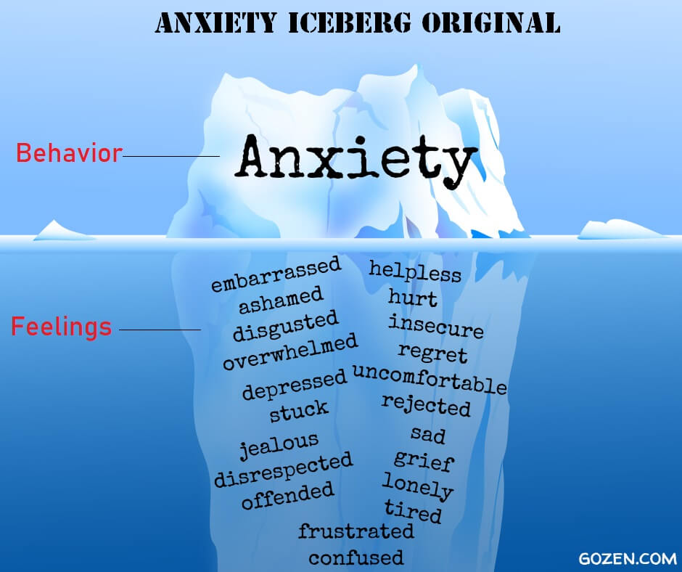
The Aim
A simple tool to allow students who are apprehensive towards the idea of help to get a head start in understanding their mental and emotional health.
Tap into an emotion rather than provide a disorder diagnosis
Help students more accurately pinpoint the root of their behaviours
The community board will help students feel supported in their journey.

Slide 4

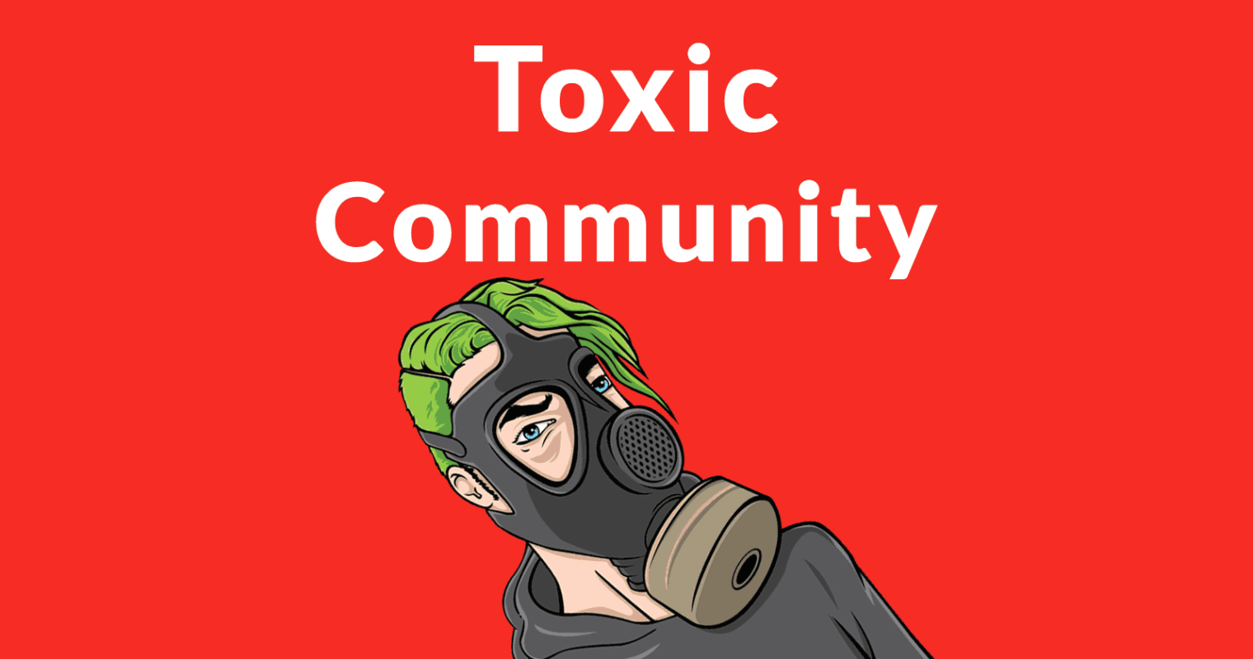
Anticipated Problems and Risks
Data privacy and protection - PHI | We will refrain from storing assessment results on the database; results will be stored only locally and temporarily. We will ensure that no user’s information will be viewable by any other user.
Community Moderation Abuse | We will keep exactly one team-owned moderator account and refrain from appointing any other users as moderators. We will not support direct messages. We will allow users to maintain anonymity by providing them auto-generated usernames
Health
Information
Personal
Information
PHI

Slide 5

Spike Exercise
Technology Stack: Firebase and React-Native (FiRN)
Firebase is a noSQL database system hosted by Google Cloud.
All reads, writes, updates, and deletes are handled through the firebase API.
The React-Native framework encompasses both the View and Controller of our app. Navigation is handled via a React-Native library.
The FiRN Tech Stack will also be used for Badger Break.

Slide 6
Roles and Responsibilities
Ryan Gillespie - Front-end Developer
Shruti Sharma - Back-end Developer, Database Administrator and Product Owner
Alex Goldsmith - Quality Assurance and UX/UI
James Deng - Scrum Master and Backend Developer
Client - Dr. Ritu Mudgal (Clinical Psychologist)

Slide 7
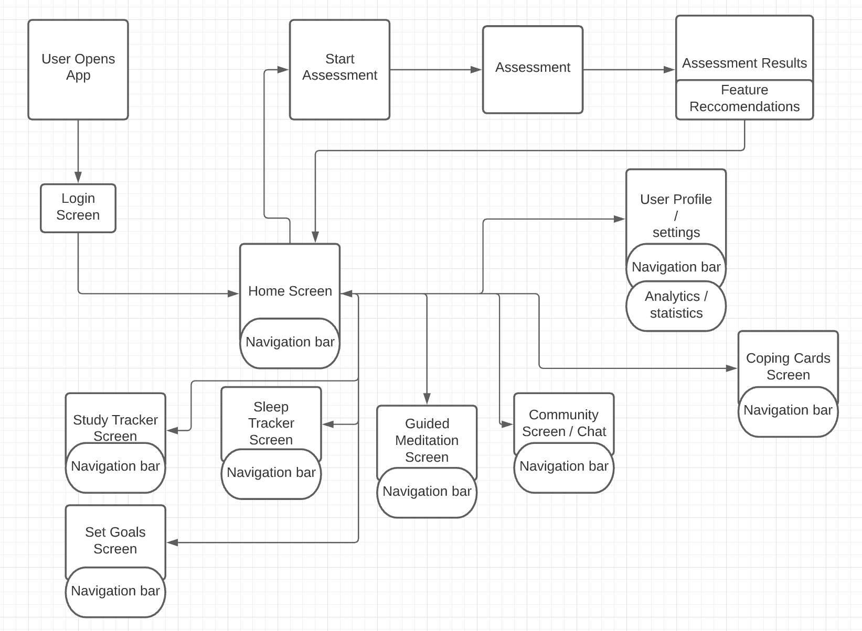
Implementation details

Slide 8
Implementation Plan
Iteration 1 Login Screen Assessment Screen Assessment Results Screen User Profile Screen | Iteration 2 Study Tracker Sleep Tracker Goals Tracker Coping Cards | Iteration 3 Guided Meditation Screen Analytics Screen Home Screen

Slide 9

Questions?

Slide 10


THANK YOU!

Slide 11
Images/Gif References
https://rackham.umich.edu/discover-rackham/graduate-student-mental-health-matters/
https://in.pinterest.com/pin/457185799657881681/
https://gozen.com/8-ways-a-childs-anxiety-shows-up-as-something-else/
http://www.gamergirlx.com/index.php/blog/90-cosplay-blog/185-it-s-ok-to-take-a-break
https://positivepsychology.com/emotion-regulation-questionnaire/
https://www.healthyhorns.utexas.edu/HT/HT_sleep.html
https://medium.com/@Dimplez/02-your-emotions-are-valid-d08b3ea560ac
https://medium.com/5bayt/authentication-with-google-and-firebase-in-react-native-e00c46fd048c
https://giphy.com/explore/code-beam-sto

